Slide 1
Management Accounting
Cost Terms, Concepts, and Classifications

Slide 2
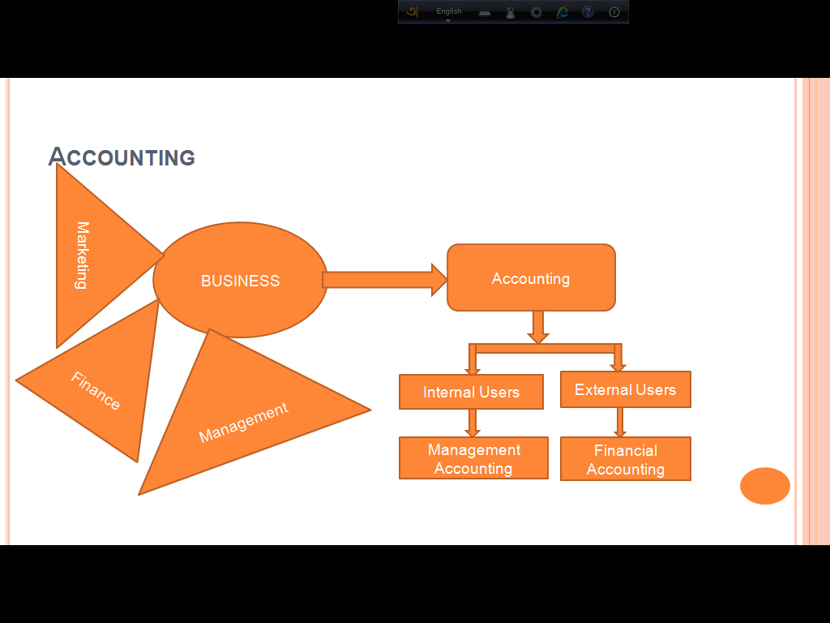

Slide 3
Definition of Cost
An amount that has to be paid or given up in order to get something. In business, cost is usually a monetary valuation of (1) effort, (2) material, (3) resources, (4) time and utilities consumed, (5) risks incurred, and (6) opportunity forgone in production and delivery of a good or service. All expenses are costs, but not all costs (such as those incurred in acquisition of an income-generating asset) are expenses.

Slide 4
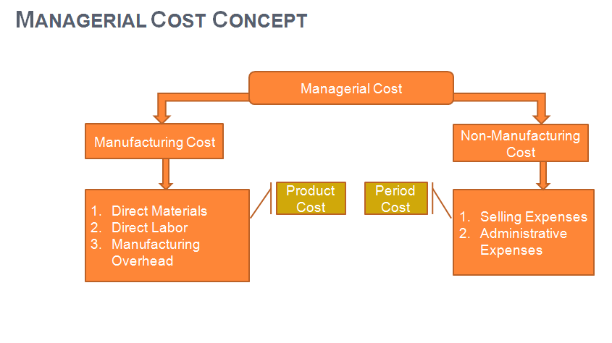

Slide 5
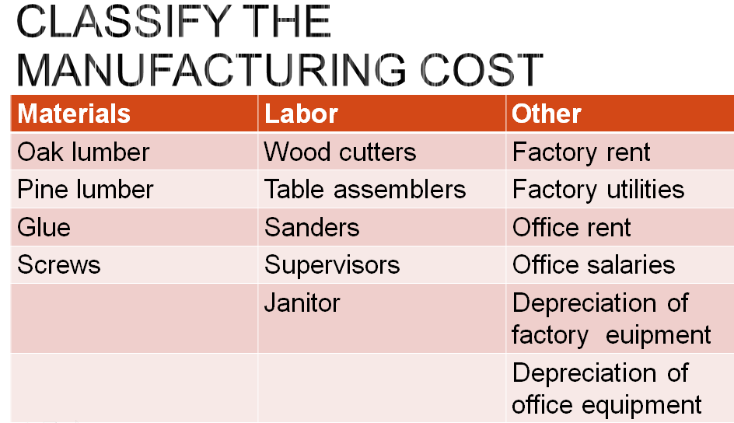

Slide 6
Manufacturing/Product Costs
Most manufacturing companies separate manufacturing costs into three broad categories: direct materials, direct labor, and manufacturing overhead.
Direct Materials: Direct or Raw materials are the basic materials and parts used in the manufacturing process.
The materials that go into the final product are called raw materials.
For example, the plastics produced by Du Pont are a raw material used by Compaq Computer in its personal computers.

Slide 7
Indirect Materials: Indirect materials have mainly two characteristics:
1. They do not physically become part of the finished product (such as lubricants and polishing compounds). Or
2. They cannot be traced because their physical association with the finished product is too small in terms of cost (such as accessories for machines: cotter pins and lock washers).

Slide 8
Labor
Direct Labor: The work of factory employees that can be physically and directly associated with converting raw materials into finished goods is direct labor.
Indirect Labor: Indirect labor refers to the work of employees that has no physical association with the finished product, or for which it is impractical to trace costs to the goods produced.

Slide 9
Manufacturing overhead:
Manufacturing overhead consists of costs that are indirectly associated with the manufacture of the finished product.
Manufacturing overhead includes indirect materials, indirect labor, depreciation on factory buildings and machines, and insurance, taxes, and maintenance on factory facilities

Slide 10
Non-manufacturing Cost Or Period Cost
Period costs are costs that are matched with the revenue of a specific time period rather than included as part of the cost of a salable product. These are also called nonmanufacturing costs.
Nonmanufacturing costs are often divided into two categories: (1) selling costs and (2) administrative costs.
In order to determine net income, companies deduct these costs from revenues in the period in which they are incurred.

Slide 11
Period Costs
Selling costs include all costs that are incurred to secure customer orders and get the finished product to the customer. These costs are sometimes called order-getting and order-filling costs.
Examples of selling costs include advertising, shipping, sales travel, sales commissions, sales salaries, and costs of finished goods warehouses.
Administrative costs include all executive, organizational, and clerical costs associated with the general management of an organization rather than with manufacturing or selling.
Examples of administrative costs include executive compensation, general accounting, secretarial, public relations, and similar costs involved in the overall, general administration of the organization as a whole.

Slide 12
Prime Cost and Conversion Cost
Prime cost is the sum of direct materials cost and direct labor cost.
(DM+DL)
Conversion cost is the sum of direct labor cost and manufacturing overhead cost. (DL+MOH)

Slide 13
Cost Classifications for Predicting Cost Behavior
Cost behavior refers to how a cost reacts to changes in the level of activity. As the activity level rises and falls, a particular cost may rise and fall as well—or it may remain constant.
To help make such distinctions, costs are often categorized as variable or fixed.

Slide 14
Variable Cost
A variable cost is a cost that varies, in total, in direct proportion to changes in the level of activity. The activity can be expressed in many ways, such as units produced, units sold, miles driven, beds occupied, lines of print, hours worked, and so forth. A good example of a variable cost is direct materials.

Slide 15
Fixed Cost
A fixed cost is a cost that remains constant, in total, regardless of changes in the level of activity. Unlike variable costs, fixed costs are not affected by changes in activity. Consequently, as the activity level rises and falls, total fixed costs remain constant unless influenced by some outside force, such as a price change.
Rent is a good example of a fixed cost. Suppose the Mayo Clinic rents a machine for $8,000 per month that tests blood samples for the presence of leukemia cells. The $8,000 monthly rental cost will be incurred regardless of the number of tests that may be performed during the month.

Slide 16
Perpetual and Periodic Inventory Systems
Inventory: Inventory is the raw materials, work-in-process products and finished goods that are considered to be the portion of a business's assets that are ready or will be ready for sale.
Perpetual inventory is a method of accounting for inventory that records the sale or purchase of inventory immediately through the use of computerized point-of-sale systems and enterprise asset management software.
Periodic inventory is a method of inventory valuation for financial reporting purposes where a physical count of the inventory is performed at specific intervals.

Slide 17
Exercise
1. The tables are made of wood that costs $100 per table. 2. The tables are assembled by workers, at a wage cost of $40 per table. 3. Workers making the tables are supervised by a factory supervisor who is paid $38,000 per year. 4. Electrical costs are $2 per machine-hour. Four machine-hours are required to produce a table. 5. The depreciation on the machines used to make the tables totals $10,000 per year. The machines have no resale value and do not wear out through use. 6. The salary of the president of the company is $100,000 per year. 7. The company spends $250,000 per year to advertise its products. 8. Salespersons are paid a commission of $30 for each table sold. 9. Instead of producing the tables, the company could rent its factory space for $50,000 per year.

Slide 18
Exercise
1. Rent on manufacturing equipment $2,000/month
2. Insurance on manufacturing building $750/month
3. Raw materials (frames, tires, etc.) $80/bicycle
4. Utility costs for manufacturing facility $1,000/month
5. Supplies for administrative office $800/month
6. Wages for assembly line workers in manufacturing facility $30/bicycle
7. Depreciation on office equipment $650/month
8. Miscellaneous materials (lubricants, solders, etc.) $1.20/bicycle
9. Property taxes on manufacturing building $2,400/year
10. Manufacturing supervisor’s salary $3,000/month
11. Advertising for bicycles $30,000/year
12. Sales commissions $10/bicycle
13. Depreciation on manufacturing building $1,500/month
Find out the manufacturing or Product Cost

Slide 19
Merchandising And Manufacturing
A merchandiser buys completed goods for resale to customers at a sufficiently high selling price to more than cover the purchase cost plus operating expenses.
A manufacturer buys materials from various suppliers and converts them into finished goods through the use of direct labor and factory overhead costs

Slide 20
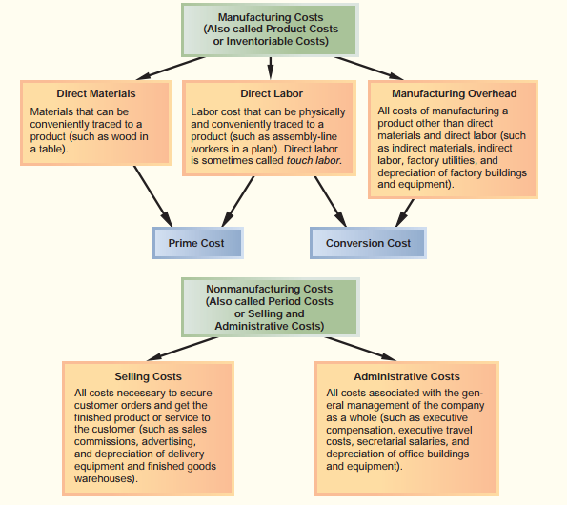

Slide 21
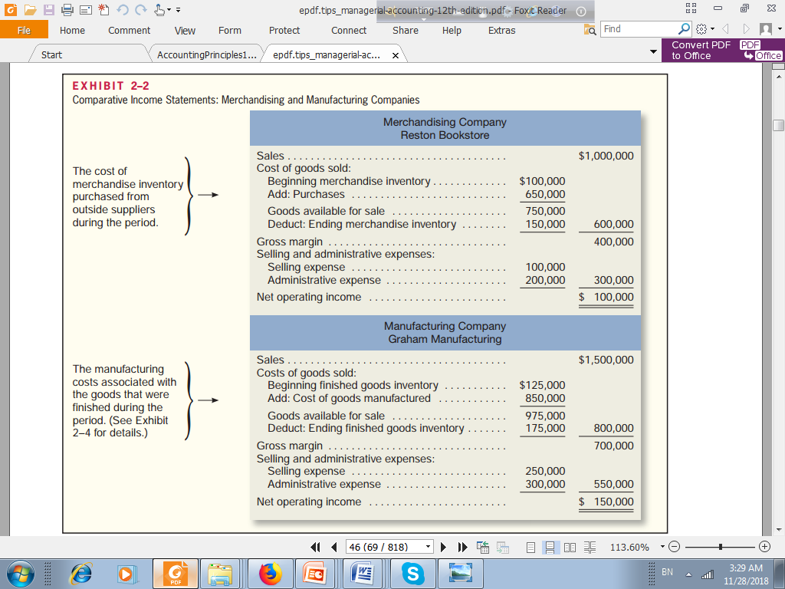

Slide 22
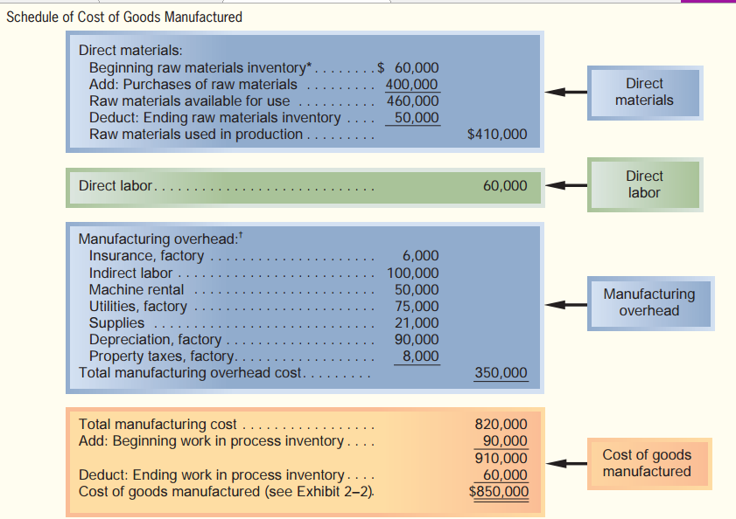
Schedule of Cost of Goods Manufactured

Slide 23
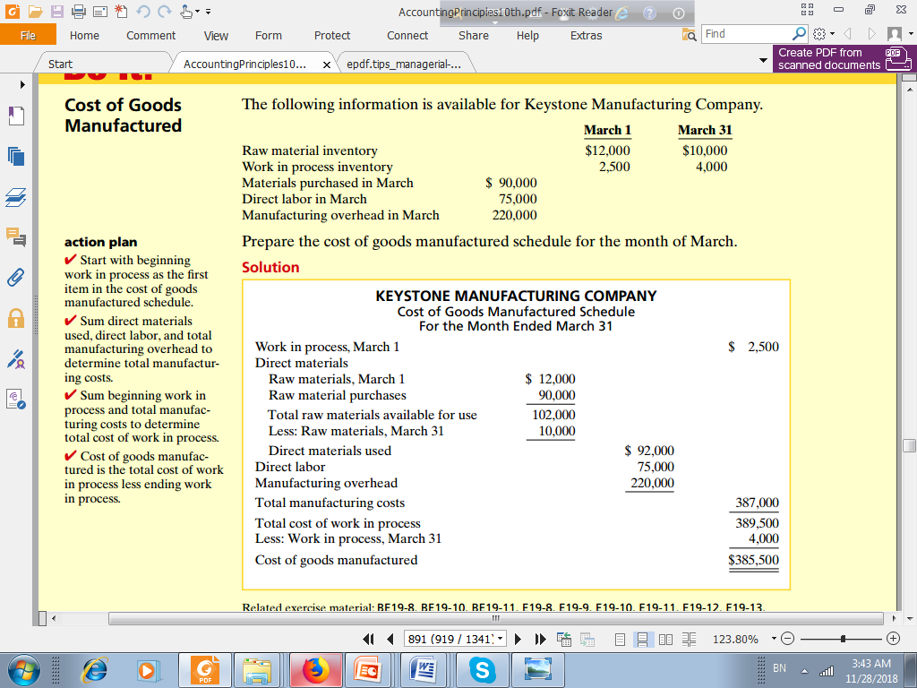
Example

Slide 24
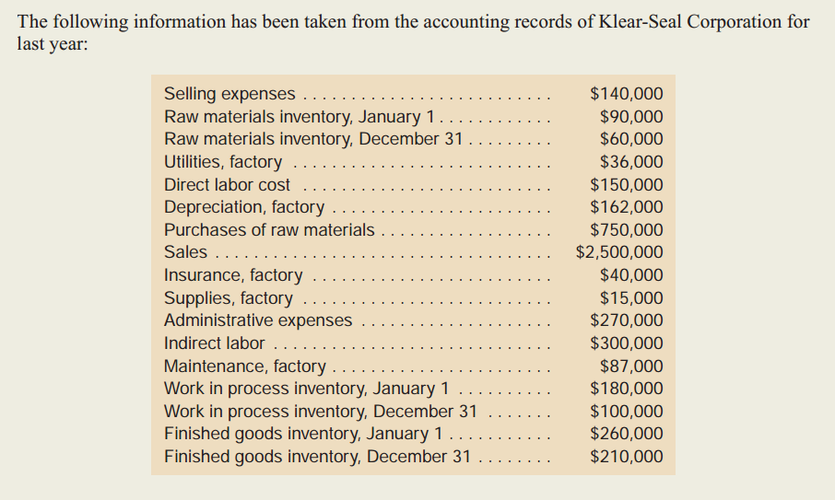
Exercise

Slide 25
Exercise cont.
Management wants these data organized in a better format so that financial statements can be prepared for the year. Required: 1. Prepare a schedule of cost of goods manufactured 2. Compute the cost of goods sold 3. Prepare an income statement.

Slide 26
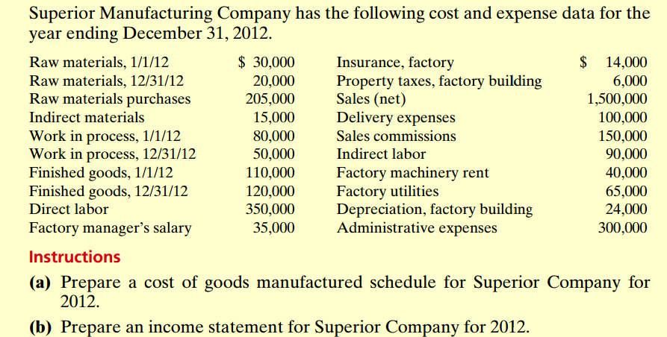
Exercise

Slide 27
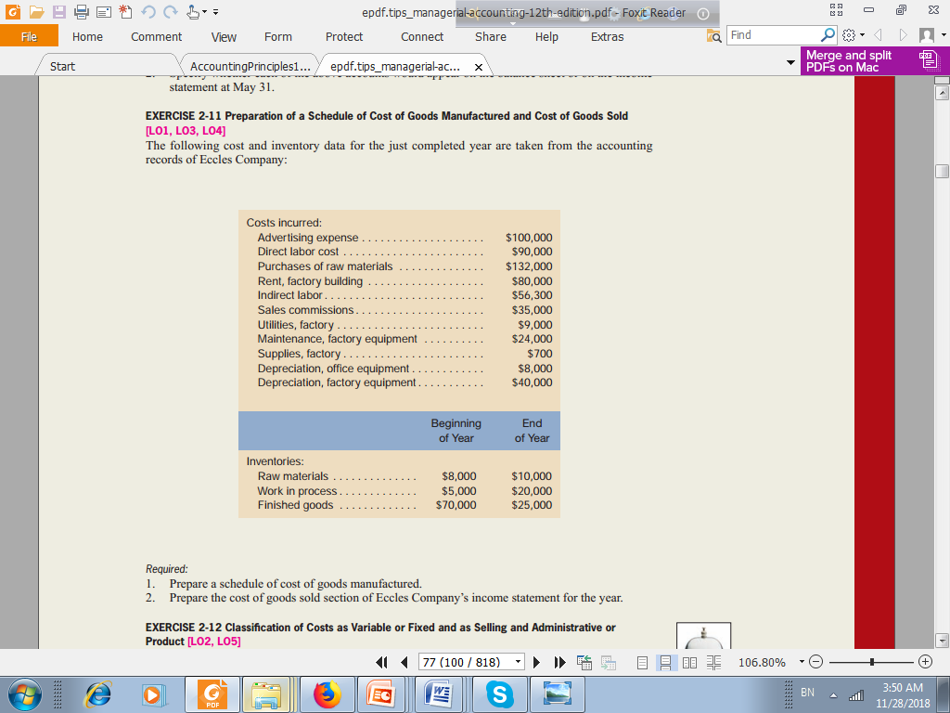
Exercise

Slide 28
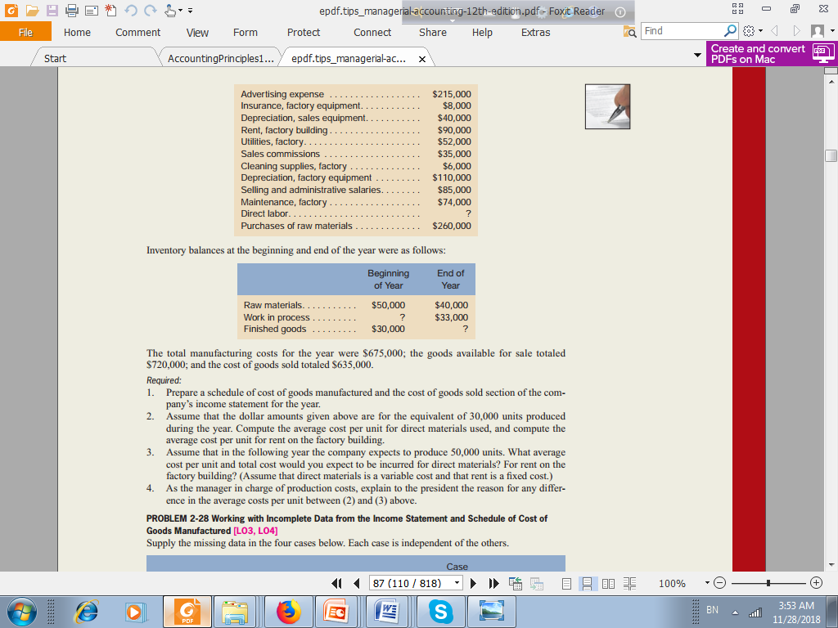
The following selected account balances for the year ended December 31 are provided for Valenko Company:

